Slide 1
One/Few Shot Learning
Problem: Accurately classifying foreign military assets given a single/few labelled samples
Conventional deep learning models trained to recognise specific objects (i.e. Is this X?)
Low generalising ability, unfeasible

Slide 2
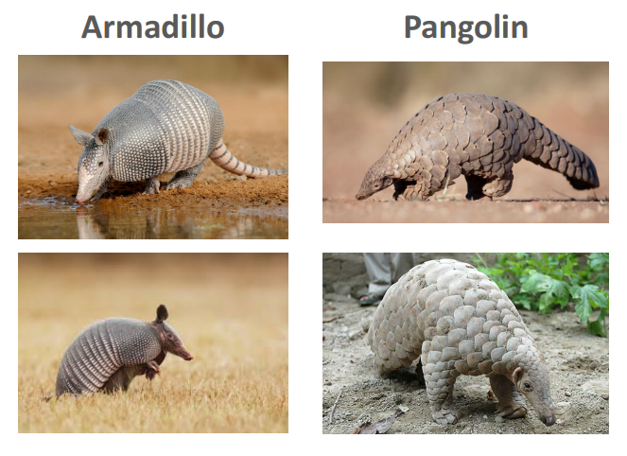

Slide 3
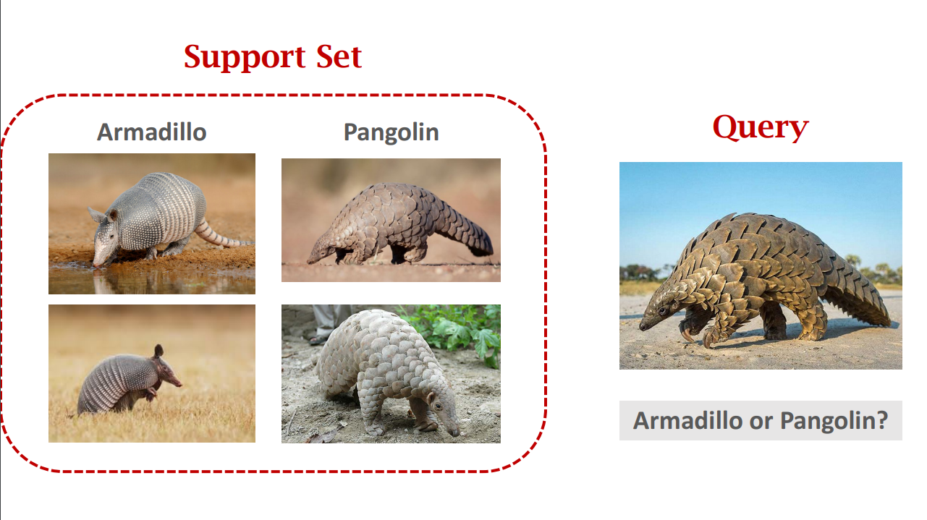

Slide 4
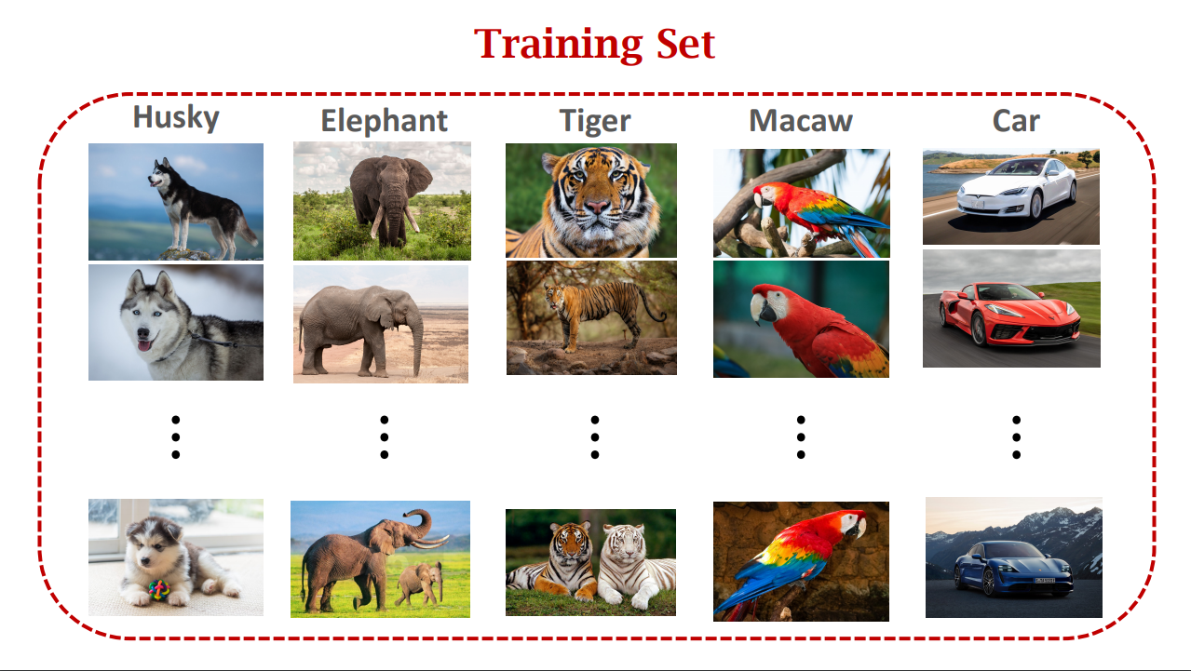

Slide 5
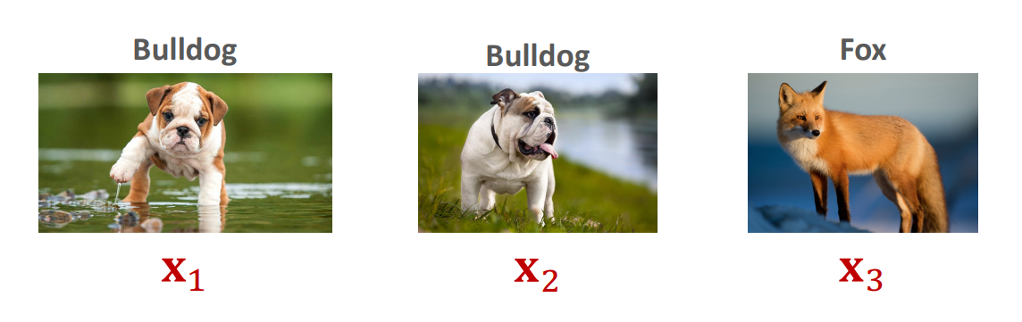
Solution
Train a model to differentiate objects, i.e. Is X similar to Y?
High generalising ability, feasible
f(x₁, x₂) = 1, f(x₁, x₃) = 0, f(x₂, x₃) = 0

Slide 6
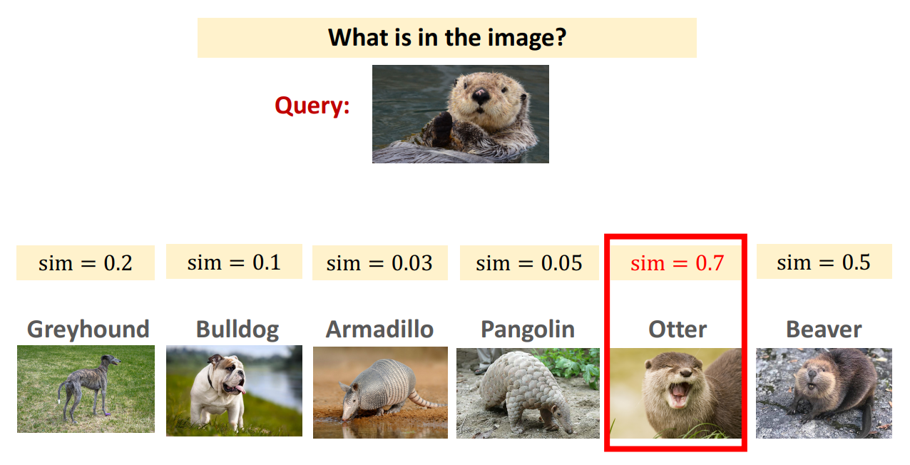

Slide 7
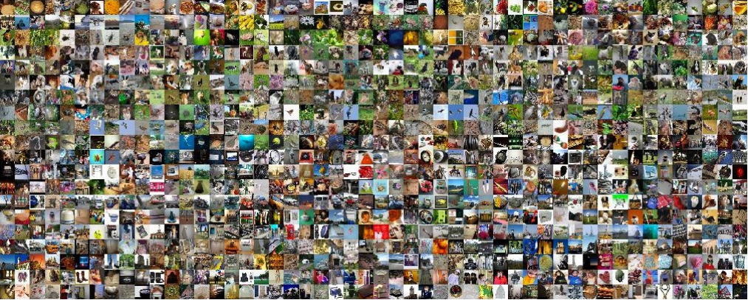
nC2 samples!
1000C2 = 499500

Slide 8
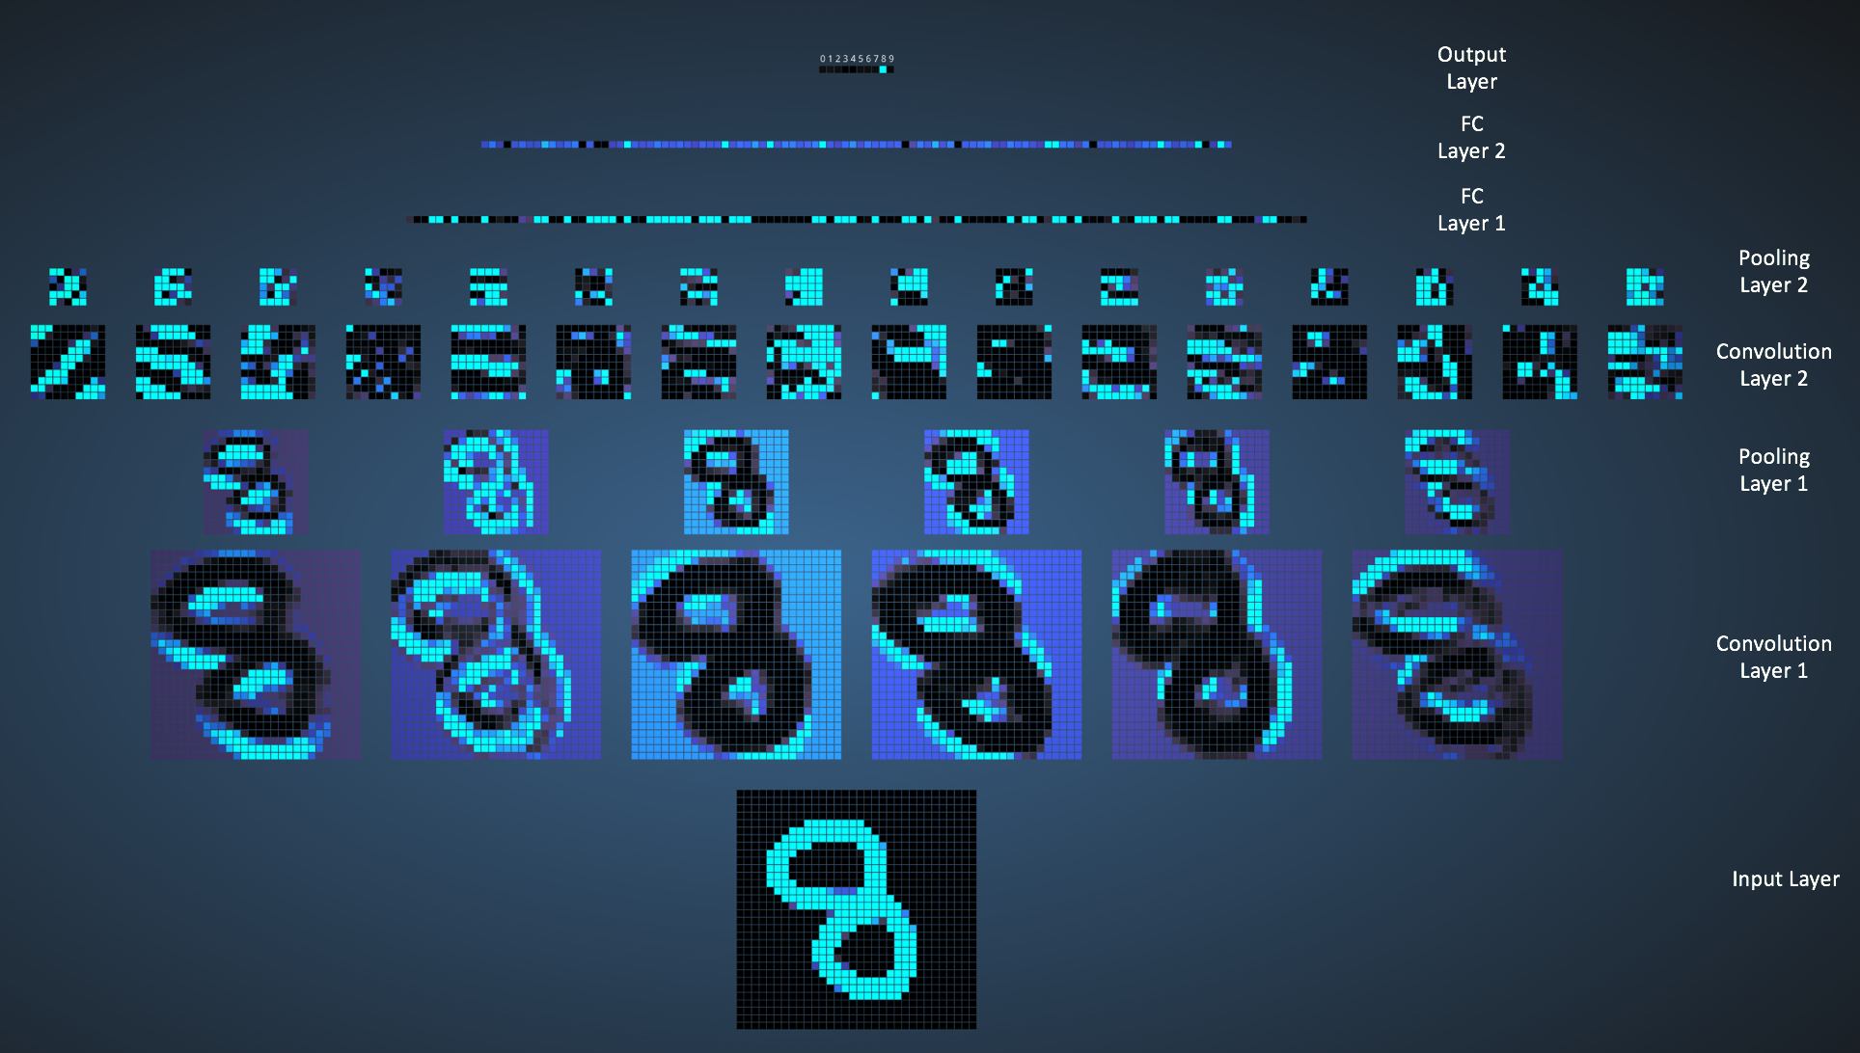

Slide 9
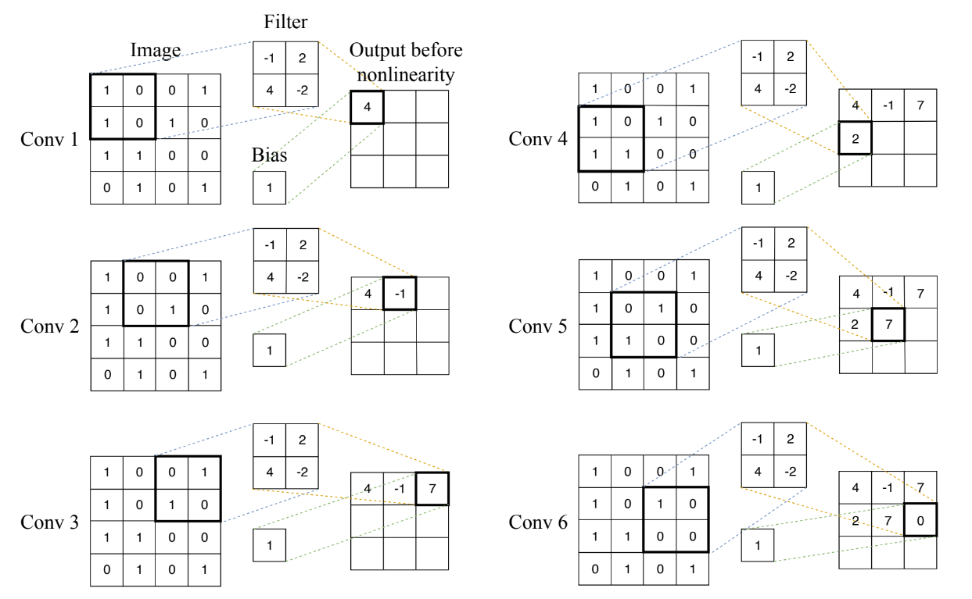

Slide 10
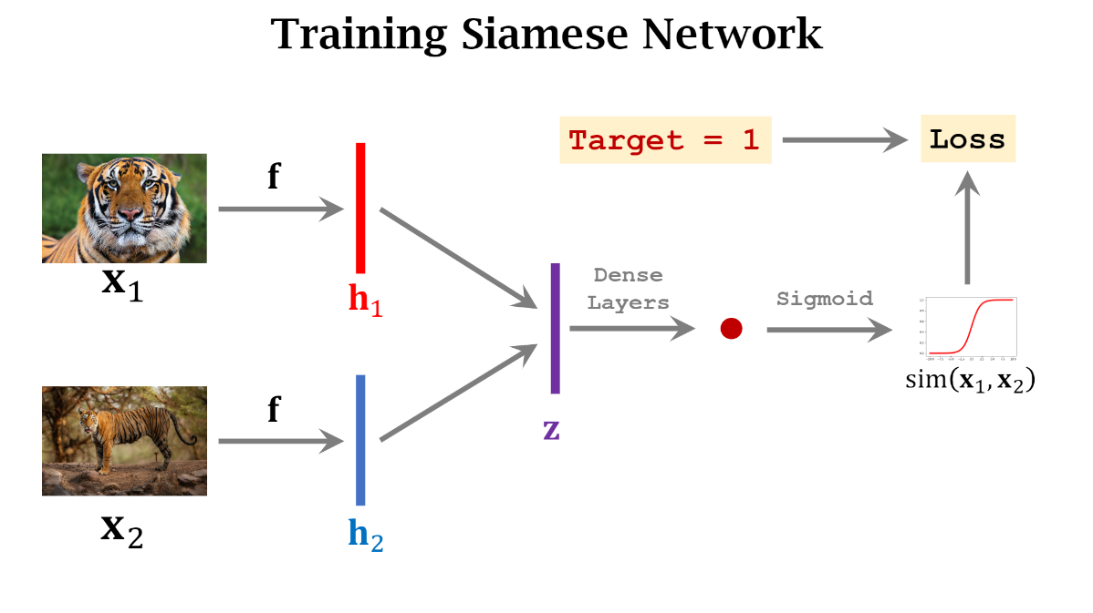

Slide 11
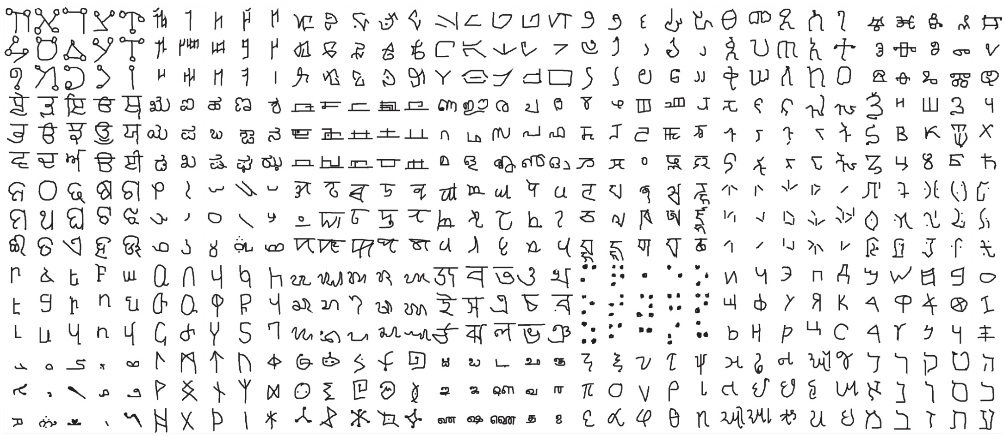
Omniglot Dataset
50 alphabets – 30 in train/validation set and 20 in evaluation set

Slide 12
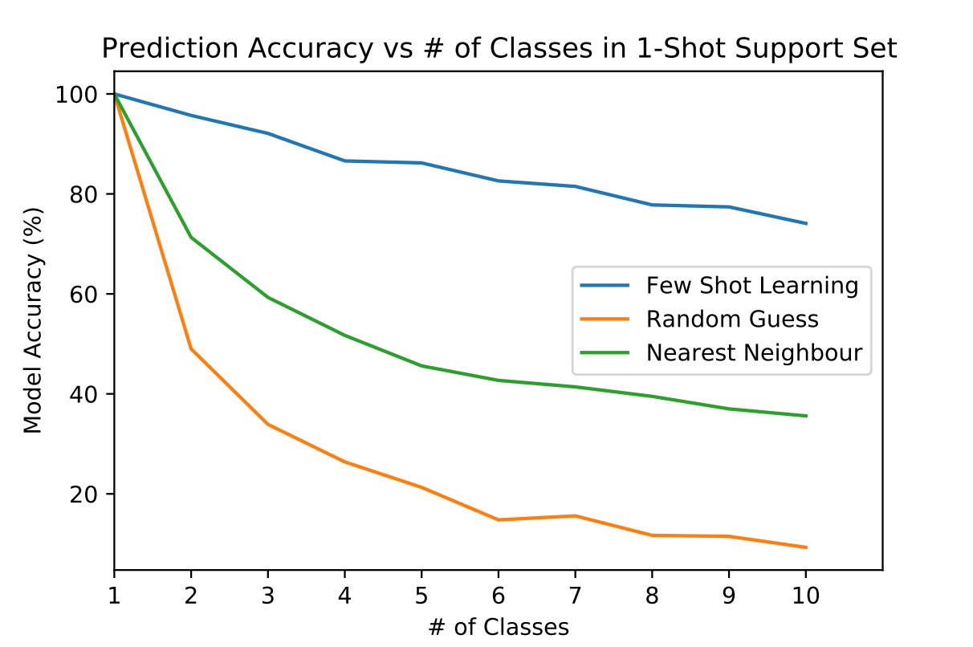
Siamese Network Results

Slide 13
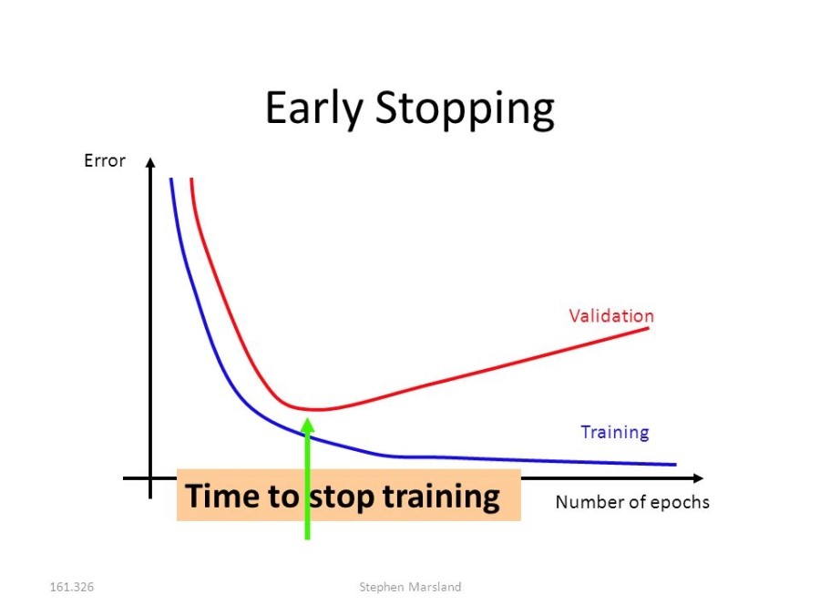

Slide 14
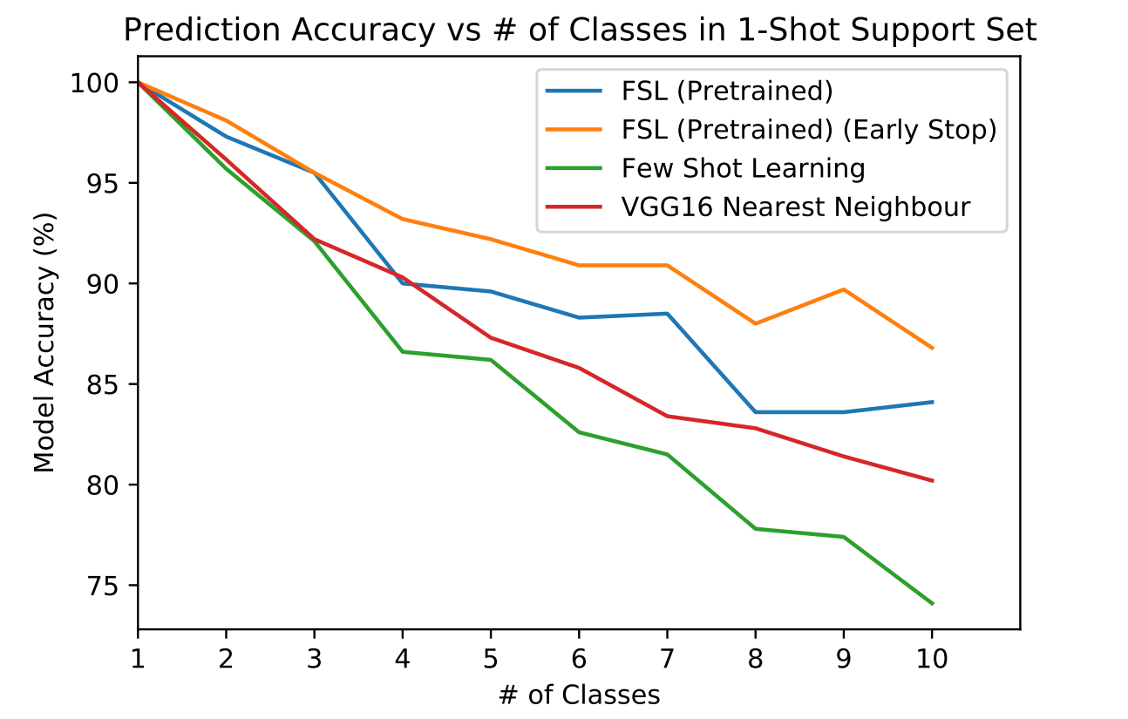
Fine-tuning Results

Slide 15
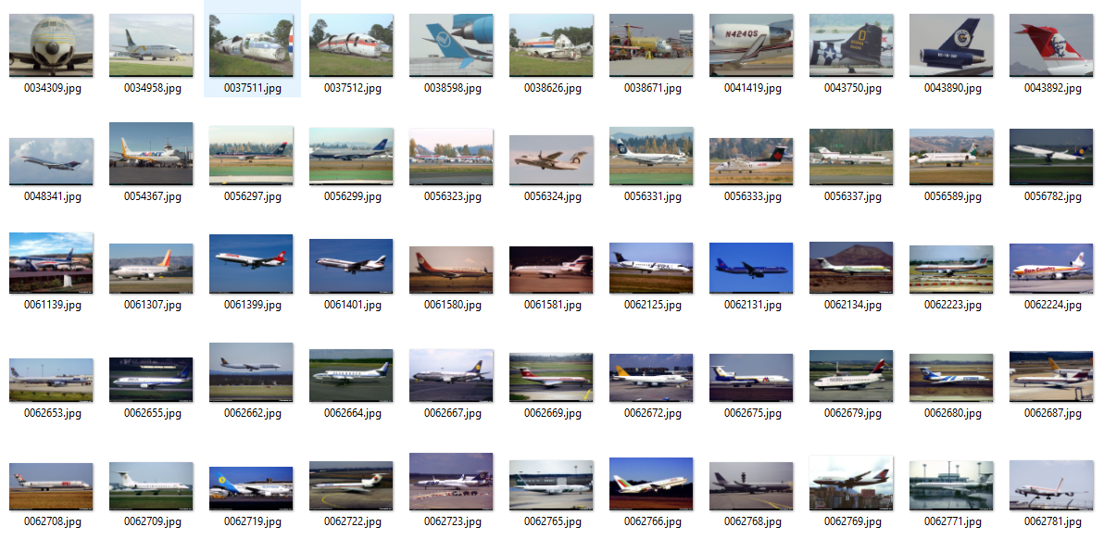
Fine Grained Visual Classification of Aircraft

Slide 16
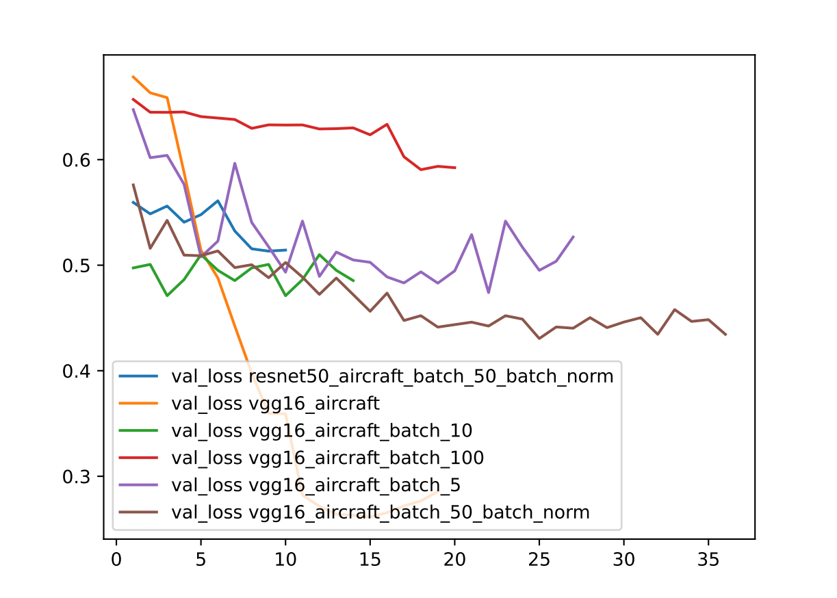
Minimising Generalisation Error

Slide 17
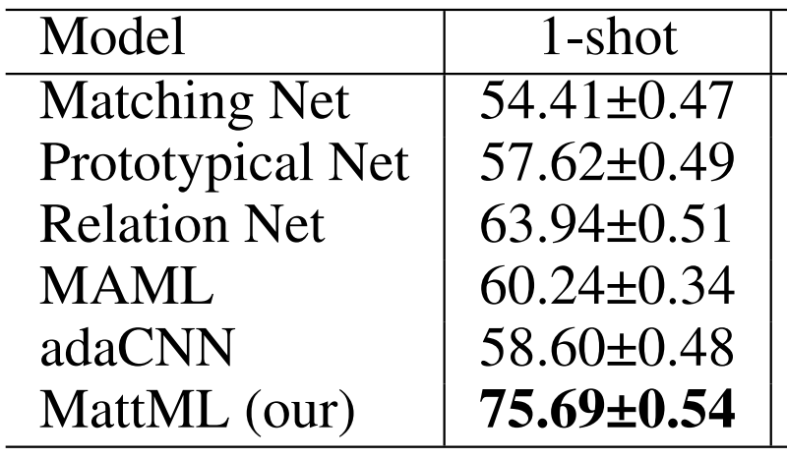
State Of the Art
Multi-attention Meta Learning for Few-shot Fine-grained Image Recognition (Yaohui Zhu, Chenlong Liu, Shuqiang Jiang)
1-shot 5-way results using 65/100 variants in dataset (my model was trained on 20/70 families of the dataset)
An aircraft family comprises of multiple variants (e.g Boeing 737 is a family. Its variants including 737-200, 737-300, etc)
Our model achieves 65.7% accuracy on 1-shot 5-way tests

Slide 18
Credits
Images adapted from:
  https://www.dsta.gov.sg/programme-centres/information-pc/striking-smarter-and-faster
  https://github.com/wangshusen/DeepLearning
  https://www.channelnewsasia.com/news/singapore/exercise-forging-sabre-apache-fighter-pilots-enemy-data-faster-11980914

